Slide 1
Regression Analysis
Multiple Linear Regression
Nicoleta Serban, Ph.D.
Professor
School of Industrial and Systems Engineering
Assumptions and Diagnostics:
Data Example

Slide 2

About This Lesson

Slide 3


Linear Regression: Example 1
Quantitative Predicting Variables:
    X₁ = The amount (in hundreds of dollars) spent on advertising in 1999
  X₂ = The total amount of bonuses paid in 1999
  X₃ = The market share in each territory
  X₄ = The largest competitor's sales
Qualitative Predicting Variable:
    X₅ = Indicates the region of the office
    (1 = south, 2 = west, 3 = midwest)
  Response Variable:
    Y = Sales (in thousands of dollars) in 1999
Sales
Advertisement

Slide 4
Residual Analysis: Example 1
Do the assumptions hold? Provide the graphical displays needed to support the diagnostics. Interpret.
If one or more assumptions do not hold, what transformations do you suggest? Did the residual diagnoses improve with the suggested transformations?
Do you identify any outliers?

Slide 5
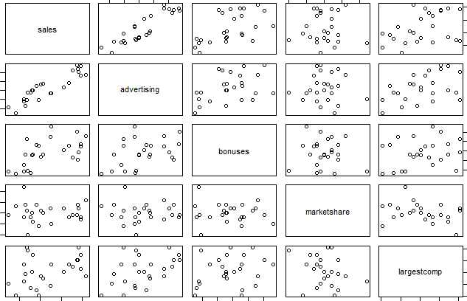
Linearity Assumption
## Scatter plot matrix of sales and numeric predicting variables
plot(meddcor[,1:5])

Slide 6
Linearity Assumption
## Scatter plot matrix of sales and numeric predicting variables
plot(meddcor[,1:5])
Linearity assumption holds for all predicting variables.
For advertisement expenditure, bonus amount, and competitor’s sales, the relationship with sales is strongly linear.

Slide 7
Linearity Assumption
## Standardized Residuals versus individual predicting variables
resids = stdres(model)
par(mfrow =c(2,2))
plot(meddcor[,2],resids,xlab="Adv Expenditure",ylab="Residuals")
abline(0,0,col="red")
plot(meddcor[,3],resids,xlab="Bonuses",ylab="Residuals")
abline(0,0,col="red")
plot(meddcor[,4],resids,xlab="Market Share",ylab="Residuals")
abline(0,0,col="red")
plot(meddcor[,5],resids,xlab="Competitor's Sales",ylab="Residuals")
abline(0,0,col="red")

Slide 8
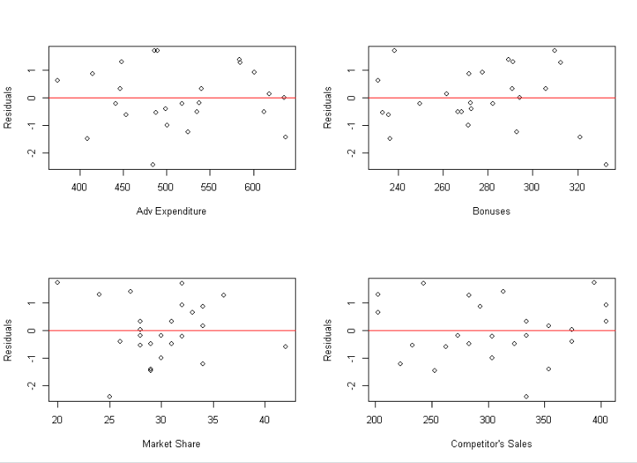
Linearity Assumption

Slide 9
Residual Analysis: Other Assumptions
library(car)
fits = model$fitted
cook = cooks.distance(model)
par(mfrow =c(2,2))
plot(fits, resids, xlab="Fitted Values",ylab="Residuals")
abline(0,0,col="red")
qqPlot(resids, ylab="Residuals", main = "")
hist(resids, xlab="Residuals", main = "",nclass=10,col="orange")
plot(cook,type="h",lwd=3,col="red", ylab = "Cook's Distance")

Slide 10
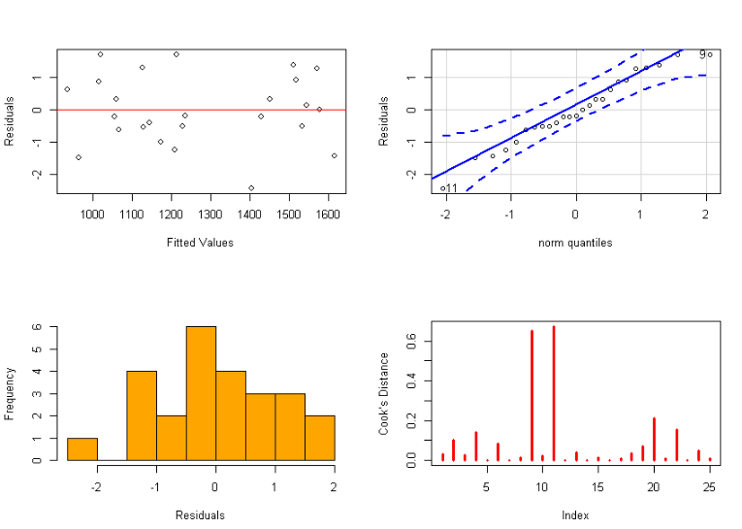
Residual Analysis: Other Assumptions

Slide 11

Summary

